Slide 1
Object-oriented Programming
Week 8 | Lecture 2

Slide 2
Operator Overloading
Defining a new behavior for common operators of a language
C++ enables you to overload most operators to be sensitive to the context in which they’re used
Using operator overloading makes a program clearer than accomplishing the same operations with function calls

Slide 3
Operator Overloading
An operator is overloaded by writing a non-static member function definition or global function definition
When operators are overloaded as member functions, they must be non-static
To use an operator on class objects (as operands), that operator “must” be overloaded

Slide 4
Operator Overloading
Operator overloading cannot change the arity (no. of operands) of an operator
Operator overloading works when at least one operand of that operator is an object
We cannot create new operators using operator overloading

Slide 5

Example
class Vector
{
int x, y;
public:
Vector( int x = 0, int y = 0)
{ this->x = x; this->y = y; }
void printXY( )
{ cout << "x: " << x << endl;
cout << "y: " << y << endl; }
Vector operator+(const Vector &ob)
{ Vector temp;
temp.x = x + ob.x;
temp.y = y + ob.y;
return temp; }
};
int main()
{
Vector v1(10, 15);
Vector v2(8, 6);
Vector v3 = v1 + v2;
v3.printXY();
}
// prints x: 18 & y: 21

Slide 6

Example
We can also define overloads for other operators in our example Vector class

Slide 7
For += operator
Vector& operator += (const Vector &ob)
{ x += ob.x;
y += ob.y;
return *this;
}

Slide 8
For Unary - operator (Negation)
Vector operator – ( ) const
{ Vector temp;
temp.x = -x;
temp.y = -y;
return temp;
}

Slide 9
For Prefix ++ operator
void operator ++ ( )
{
++x;
++y;
}
(Works the same way for prefix decrement operator)

Slide 10
For Postfix ++ Operator
Vector operator ++ ( int )
{
Vector temp;
temp.x = x++;
temp.y = y++;
return temp;
}

Slide 11
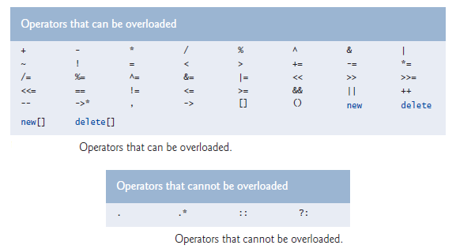
Restrictions on Operator Overloading

Slide 12
Friend Function
A global friend function is one which can access private members of a class.
Though a global friend function can access or modify the private instance members of a class directly, it still however needs an object of the class to do so.
Access modifiers have not effect on friend function prototype inside class

Slide 13
Example
class A { int var; // private data member
friend void func( ); };
void func( ) {
A ob; ob.var = 50; // can directly access var }

Slide 14
Friend Class
Just like global friend functions, a friend class is one which can directly access private members of a class
The private members of a class can be referenced directly in all member functions of its friend class
However, an object would still be required to access the private members

Slide 15
Example
class A { int var; // private data member
friend class B; };
class B {
A ob; public:
B( ) { ob.var = 10; // can directly access var } };

Slide 16


Next Topic
Abstract class

